Slide 1
Introduction to Java
www.cybage.com
Copyright © 2019 Cybage Software Pvt. Ltd. All Rights Reserved. Cybage Confidential. www.cybage.com

Slide 2
Agenda
History of Java
Features of Java
Data types in Java
Access Modifiers
Writing first Java Class
Accessors and Mutators
Constructors
‘this’ keyword
www.cybage.com

Slide 3
History of Java
Background : Sun Microsystems set up a project called “Project Green” to develop a platform independent language for embedded systems.
The Language was first named as “OAK”.
Then it was renamed as “Java” (One programming language with this name was already in existence)
Java was dismissed earlier but again gained popularity when WWW became popular
Though it is associated with the World Wide Web, it is older than the origin of Web.
www.cybage.com

Slide 4
Features of Java
Simple
Object Oriented
Architecture Neutral
Portable
Robust
Interpreted
Distributed
Dynamic
Secure
Multithreaded
www.cybage.com

Slide 5
Simple
No Header files
No Pointer arithmetic
No Operator overloading
Syntax similar to C++
www.cybage.com

Slide 6
Robust
Memory management is done by the system.
Developer need not have to worry about problems associated with pointers like:
Bad Pointers
Memory Leakage
Strong Exception Handling mechanism that includes Compile time and dynamic checking.
www.cybage.com

Slide 7
Architecture Neutral
Output of compilation of a .java file /java source code is a .class file.
It is also called as Bytecode.
Generated bytecode is platform independent which can be transferred to any particular
platform / os.
www.cybage.com

Slide 8
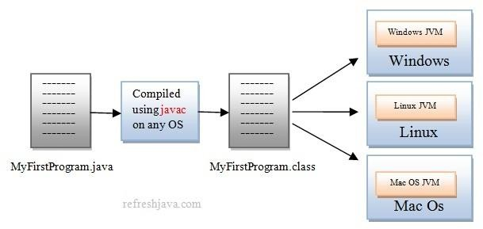
Java : Platform Independent
www.cybage.com

Slide 9
Java Environment
.Java
.class
compile
bytecode
Class Loader
Byte code verifier
safe byte code
JVM—java runtime
Interpreter
Native OS
www.cybage.com

Slide 10
Secured, Interpreted
Secure -
Java is intended for use in networked/distributed environments.
Therefore a lot of emphasis has been placed on security.
Java enables the construction of virus-free, tamper-free systems.
Interpreted Java byte codes are translated on the fly to native machine instructions (interpreted).
classes are linked on need basis.
www.cybage.com

Slide 11
Portable
The sizes of the primitive data types are specified.
Behavior of basic datatype sizes & arithmetic operators is consistent across the platforms.
For example, "int“ always a 32 bit integer.
Standard Unicode format is used for storing Strings.
www.cybage.com

Slide 12
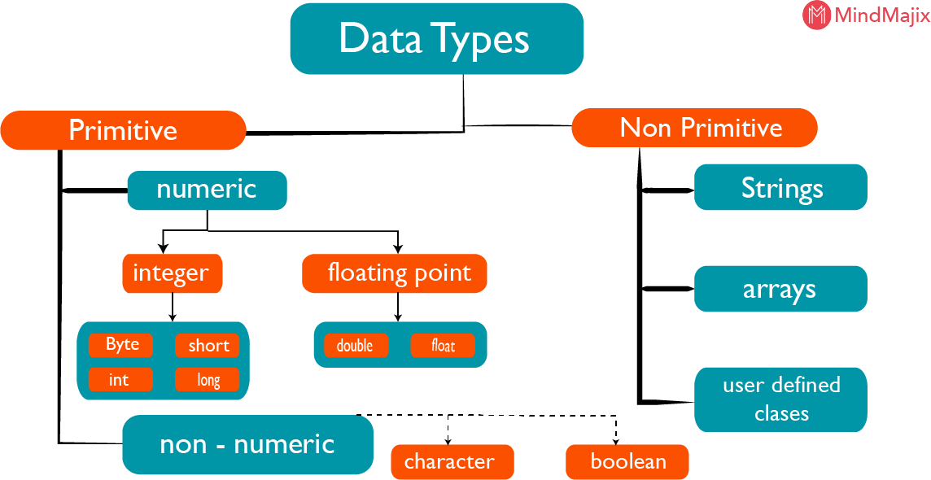
www.cybage.com

Slide 13
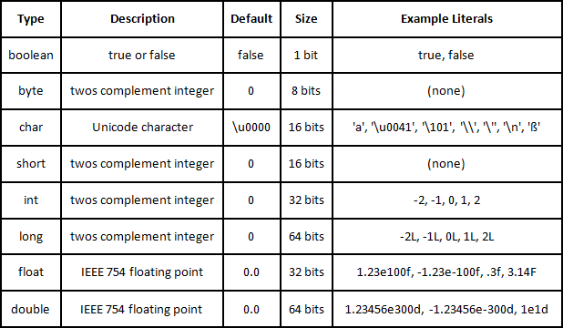
Default Values of Datatype
www.cybage.com

Slide 14
Access Modifiers
As the name suggests access modifiers in Java helps to restrict the scope of a class, constructor , variable , method or data member. There are four types of access modifiers available in java:
default – No keyword required
private
protected
public
www.cybage.com

Slide 15
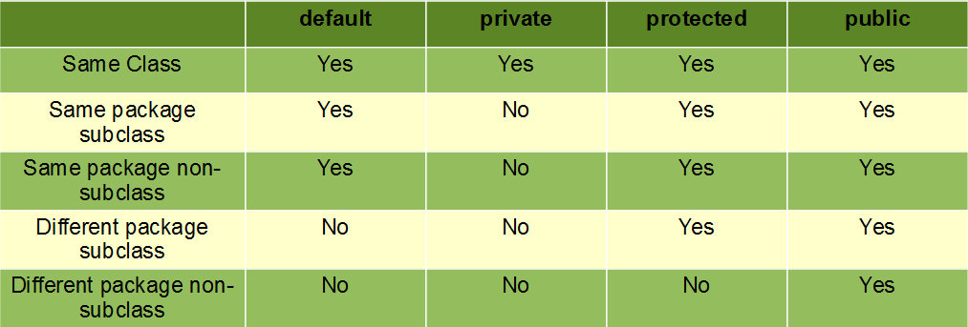
Access Modifiers
www.cybage.com

Slide 16
Writing First Java Class
public class Employee {
int age;
String name, desgn;
public void setEmployeeDetails(int age, String name, String desgn) {
this.age = age; this.name = name; this.desgn = desgn;
}
public void getEmployeeDetails() { System.out.println("Employee Data is=> Name: "+this.name+" and Designation is: "+this.desgn);
}
}
public class Test {
public static void main(String[] args) { Employee firstEmp=new Employee(); firstEmp.setEmployeeDetails(34,"John","SE"); firstEmp.getEmployeeDetails();
}
}
www.cybage.com

Slide 17
Class is a blueprint for Object
In software, a class is a description of an object:
A class describes the data that each object includes.
A class describes the behaviors that all objects exhibits.
A class represents the structure of the object
An object is called as an instance of class
www.cybage.com

Slide 18
Accessors and Mutators
Data is encapsulated inside an object
Methods are required to set, access or to modify this data.
Mutators or Setters – the methods to set data into an object.
Naming convention:
public void setXXX(…){}
Accessors or Getters :The methods to access the data from an object
Naming convention :
public datatype getXXX(){}
www.cybage.com

Slide 19
Accessing Object Members
Accessing Object Members
The dot notation is: <object>.<member>
This is used to access object members, including attributes and methods.
Examples of dot notation are:
d.display();
d.age = 42;
www.cybage.com

Slide 20
Accessors and Mutators
class Employee
{
int age; Stirng name;
public void setAge(int a) {
this.age=a;
}
// setter or mutator
public int getAge() //getter or accessor { return age;
}
}
www.cybage.com

Slide 21
Constructor
Constructor is a special method:
Its name is same as class name
Constructor does not have any return type
(not even void)
It gets invoked implicitly whenever a new object is created
Constructors can be overloaded
www.cybage.com

Slide 22
Default Constructor
The Default Constructor
There is always at least one constructor for every class
If the programmer does not supply any constructor explicitly, the default constructor will be created and executed implicitly.
The default constructor takes no parameters
The default constructor body is empty.
www.cybage.com

Slide 23
Constructor With Parameter
You can pass parameters to a constructor.
Example:
public class Employee
{
private int age;
public Employee(int age)
{
age = 42;
}
}
www.cybage.com

Slide 24
“this” Keyword
“this” is a keyword in java
it points to the current invoking object
every class member gets a hidden reference – ”this”
For d1.display() or d1.dd :
here current invoking object is “d1” so ‘this’ points to d1
www.cybage.com

Slide 25
Demo : ‘this’
class Machine
{
String modelName;
public Machine()
{
System.out.println(“To automate users tasks. ”);
}
public Machine(String name)
{
this(); //……constructor chaining
this.name=name;
}
}
www.cybage.com

Slide 26

www.cybage.com

Slide 27



Thank You!
www.cybage.com
Copyright © 2019 Cybage Software Pvt. Ltd. All Rights Reserved. Cybage Confidential._{5/12/2021} www.cybage.com 27

